Slide 1
Investigate Data Leakage Case
Keywords: Windows Security Event Logs, XML, Python
Notes:
http://xmlstar.sourceforge.net/doc/UG/

Slide 2
Topics
Introduction to XML
Retrieve information from bookstore.xml file
Investigate Windows Security Event Logs
binary logs are converted to a .xml file

Slide 3
Introduction to XML

Slide 4
What is XML
An XML file is an eXtensible Markup Language file that structures data for storage and transport.
XML files can be used for various purposes
Data transfer: XML files can store and retrieve data for different applications.
Formatting documents: XML files can define how web pages or other documents are displayed.
Web searching: XML files can help search engines index and rank web pages
Creating layouts: XML files can design the user interface of mobile applications.
Storing configuration data: XML files can store the settings and preferences of an application.

Slide 5
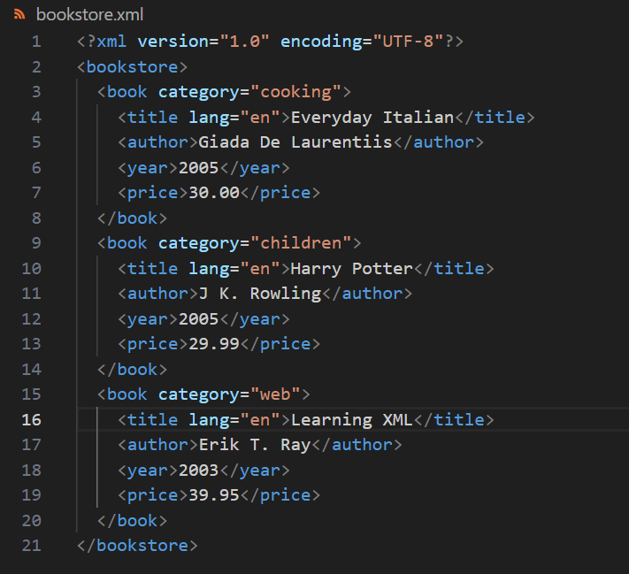
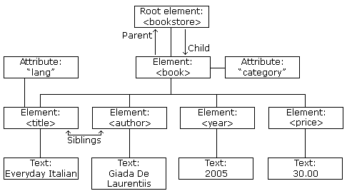
UTF-8 is capable of encoding all 1,112,064 characters using one to four one-byte (8-bit) code units.
https://www.w3schools.com/xml/xml_tree.asp
Notes:
<?xml version="1.0" encoding="UTF-8"?>
<bookstore>
<book category="cooking">
<title lang="en">Everyday Italian</title>
<author>Giada De Laurentiis</author>
<year>2005</year>
<price>30.00</price>
</book>
<book category="children">
<title lang="en">Harry Potter</title>
<author>J K. Rowling</author>
<year>2005</year>
<price>29.99</price>
</book>
<book category="web">
<title lang="en">Learning XML</title>
<author>Erik T. Ray</author>
<year>2003</year>
<price>39.95</price>
</book>
</bookstore>

Slide 6
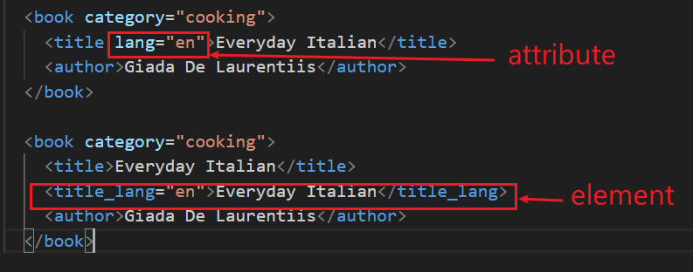


XML Elements vs. Attributes
Both examples provide the same information about the language of the title.
Avoid attributes, use elements instead

Slide 7
Retrieve information from bookstore.xml

Slide 8
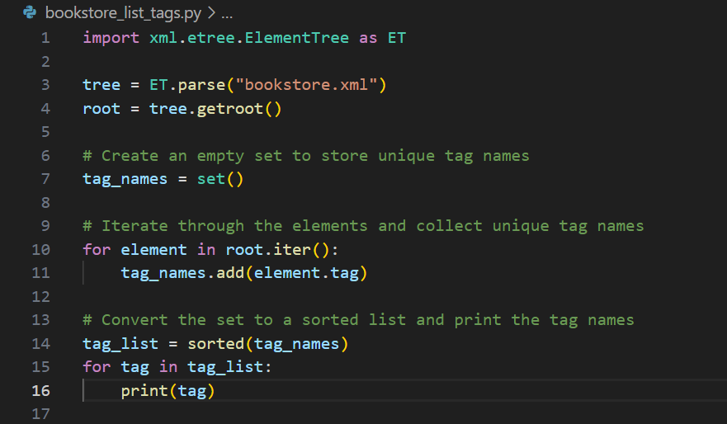
List all tags of bookstore.xml

Slide 9
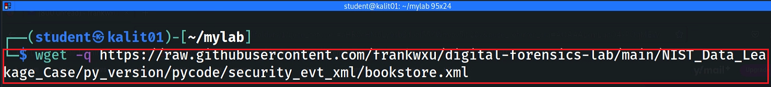
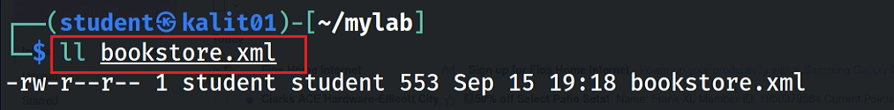
Download lab xml file bookstore.xml
Notes:
wget https://raw.githubusercontent.com/frankwxu/digital-forensics-lab/main/NIST_Data_Leakage_Case/py_version/pycode/security_evt_xml/bookstore.xml

Slide 10
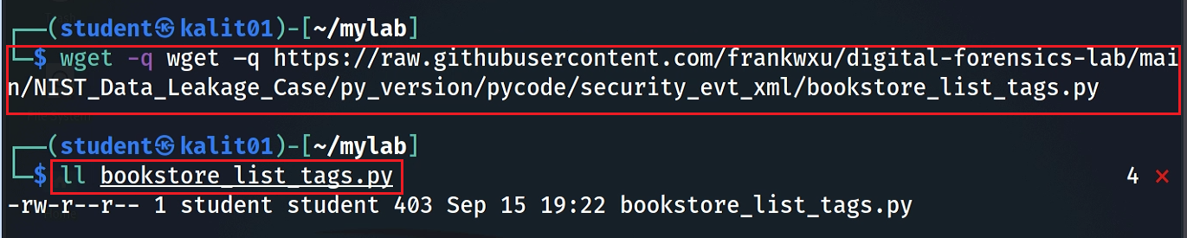
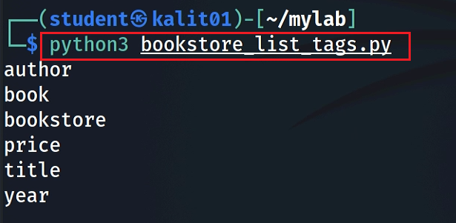
Download python code
Execution results: list all tags
Notes:
wget –q https://raw.githubusercontent.com/frankwxu/digital-forensics-lab/main/NIST_Data_Leakage_Case/py_version/pycode/security_evt_xml/bookstore_list_tags.py

Slide 11
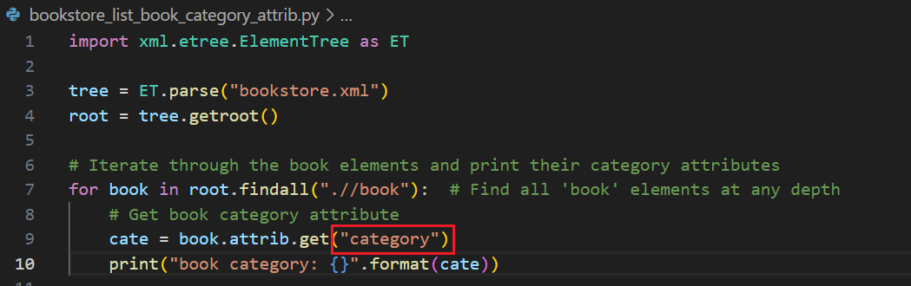
List a book attribute: category

Slide 12

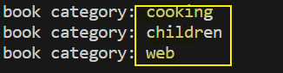
https://raw.githubusercontent.com/frankwxu/digital-forensics-lab/main/NIST_Data_Leakage_Case/py_version/pycode/security_evt_xml/bookstore_list_book_category_attrib.py
Execution command
$ python3 bookstore_list_book_category_attrib.py
Execution results

Slide 13
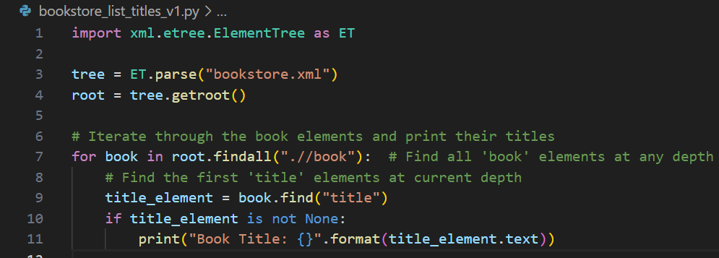
List a book tag: title and its text

Slide 14
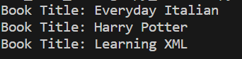
https://raw.githubusercontent.com/frankwxu/digital-forensics-lab/main/NIST_Data_Leakage_Case/py_version/pycode/security_evt_xml/bookstore_list_book_titles_v1.py
Execution command
$ python3 bookstore_list_titles_v1.py
Execution results

Slide 15
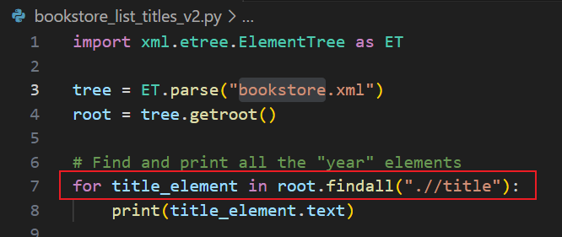
https://raw.githubusercontent.com/frankwxu/digital-forensics-lab/main/NIST_Data_Leakage_Case/py_version/pycode/security_evt_xml/bookstore_list_book_titles_v2.py
List a book tag: category and its text (alternative)

Slide 16
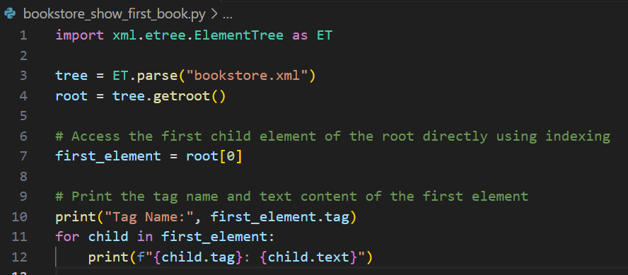
Show the first book details

Slide 17
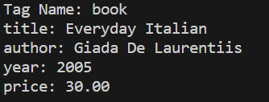
https://raw.githubusercontent.com/frankwxu/digital-forensics-lab/main/NIST_Data_Leakage_Case/py_version/pycode/security_evt_xml/bookstore_show_first_book.py
Execution command
$ python3 bookstore_show_first_book.py
Execution results

Slide 18
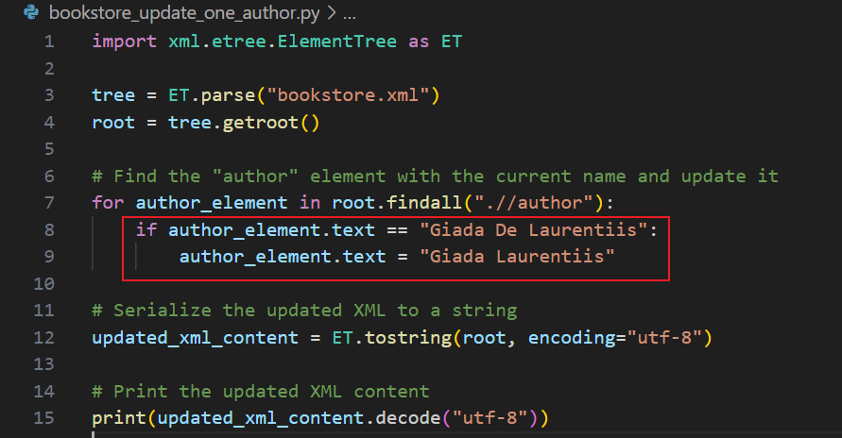
Update one author
"Giada Laurentiis"

Slide 19
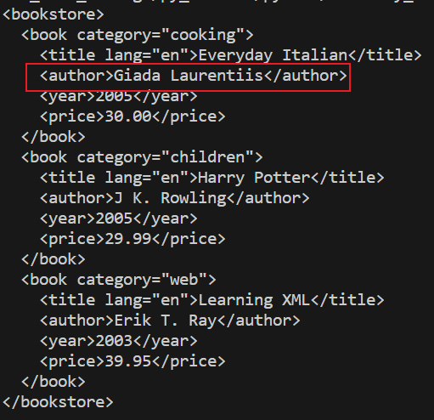
https://raw.githubusercontent.com/frankwxu/digital-forensics-lab/main/NIST_Data_Leakage_Case/py_version/pycode/security_evt_xml/bookstore_update_one_author.py
Execution command
$ python3 bookstore_update_one_author.py
Execution results

Slide 20
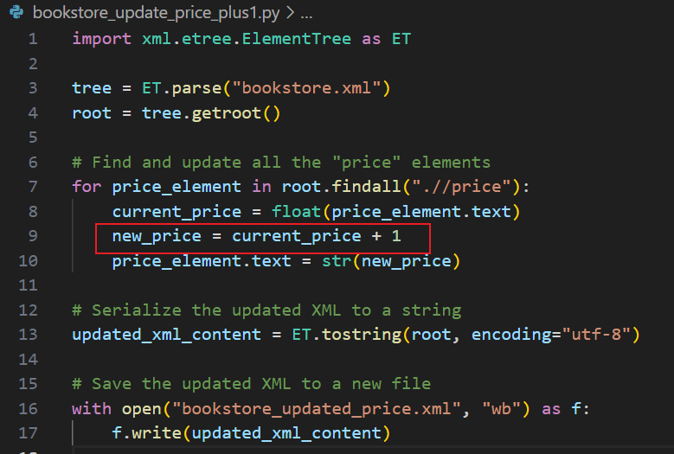
Update price with price +1

Slide 21
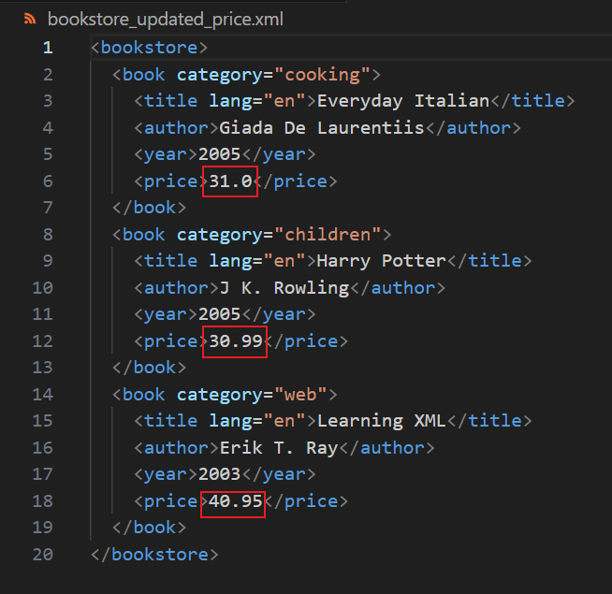
https://raw.githubusercontent.com/frankwxu/digital-forensics-lab/main/NIST_Data_Leakage_Case/py_version/pycode/security_evt_xml/bookstore_update_price_plus1.py
Execution command
$ python3 bookstore_update_price_plus1.py
Execution results

Slide 22
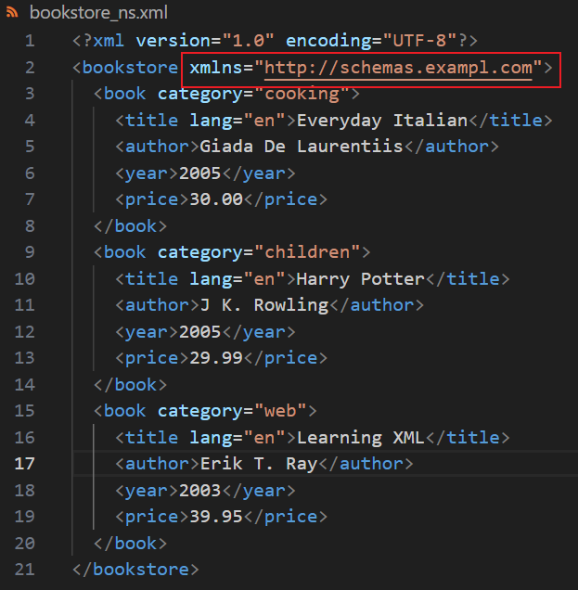
Remove namespace in XML
A namespace is a mechanism that allows you to uniquely identify elements and attributes within an XML document.
It's used to avoid naming conflicts when different XML vocabularies or documents are combined or used together.
Namespaces are particularly useful when
you have XML documents that contain elements and attributes with the same names, but they are intended to represent different things.
XML Namespaces provide a method to avoid element name conflicts.
defined by an xmlns attribute in the start tag of an element.
xmlns:prefix="URI".

Slide 23
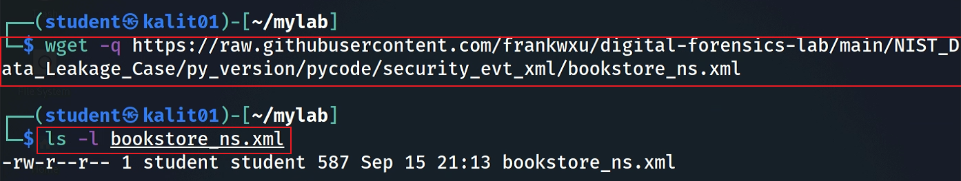
Download bookstore with the namespace
Notes:
wget -q https://raw.githubusercontent.com/frankwxu/digital-forensics-lab/main/NIST_Data_Leakage_Case/py_version/pycode/security_evt_xml/bookstore_ns.xml

Slide 24
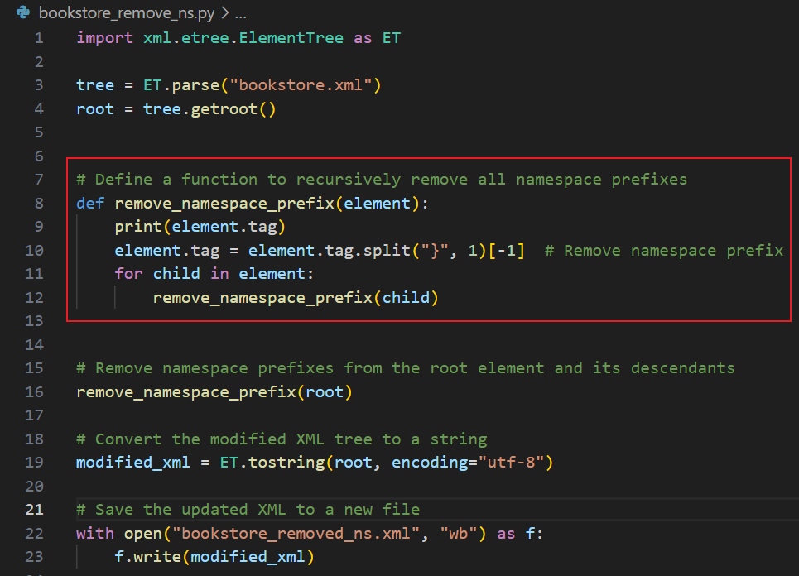

Slide 25
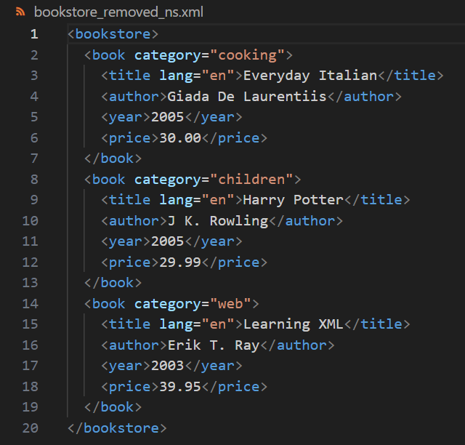
https://raw.githubusercontent.com/frankwxu/digital-forensics-lab/main/NIST_Data_Leakage_Case/py_version/pycode/security_evt_xml/bookstore_remove_ns.py
Execution command
$ python3 bookstore_remove_ns.py
Execution results

Slide 26
Investigate Windows Security Event Logs

Slide 27
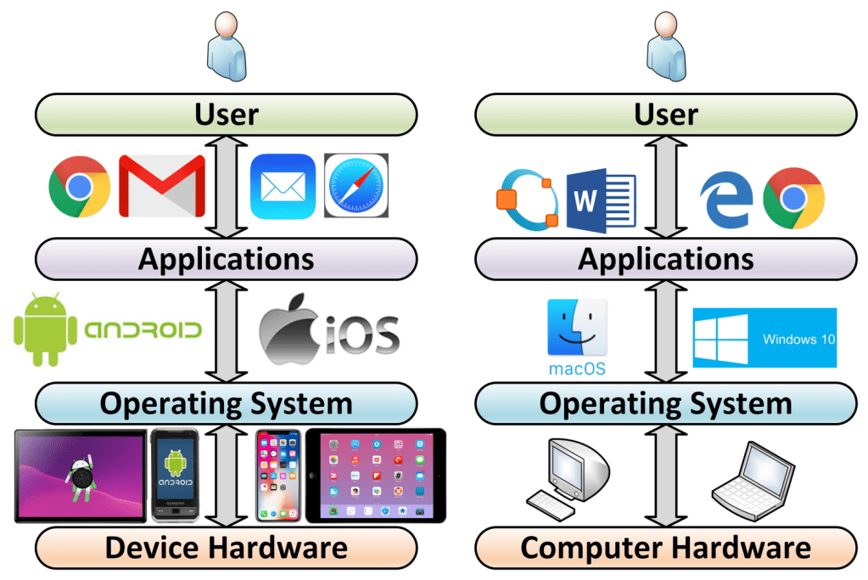
Layers of a computer system and evidence generation
Evidence is generated from each layer
User activities= Applications+ OS+ Disk/Memory
https://windsongtraining.ca/the-technology-layer-cake-users-apps-os-and-hardware/

Slide 28
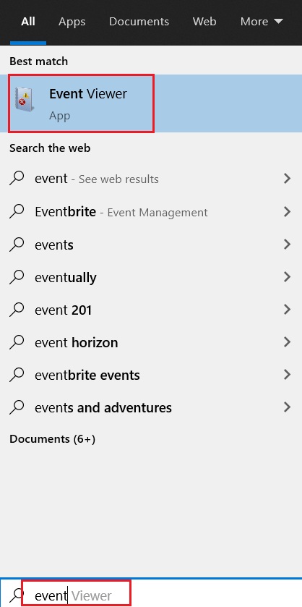
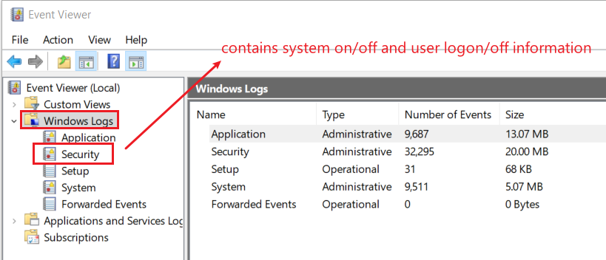
12. List all traces about the system on/off and the user logon/logoff (It should be considered only during a time range between 09:00 and 18:00 in the timezone (Eastern Time) from Question 4.
The Windows event log is a detailed record of system, security and application notifications stored by the Windows
It’s a useful tool for
troubleshooting all kinds of different Windows problems
forensics analysis
Notes:
evtx_dump.py Security.evtx > SecurityEvt.xml

Slide 29
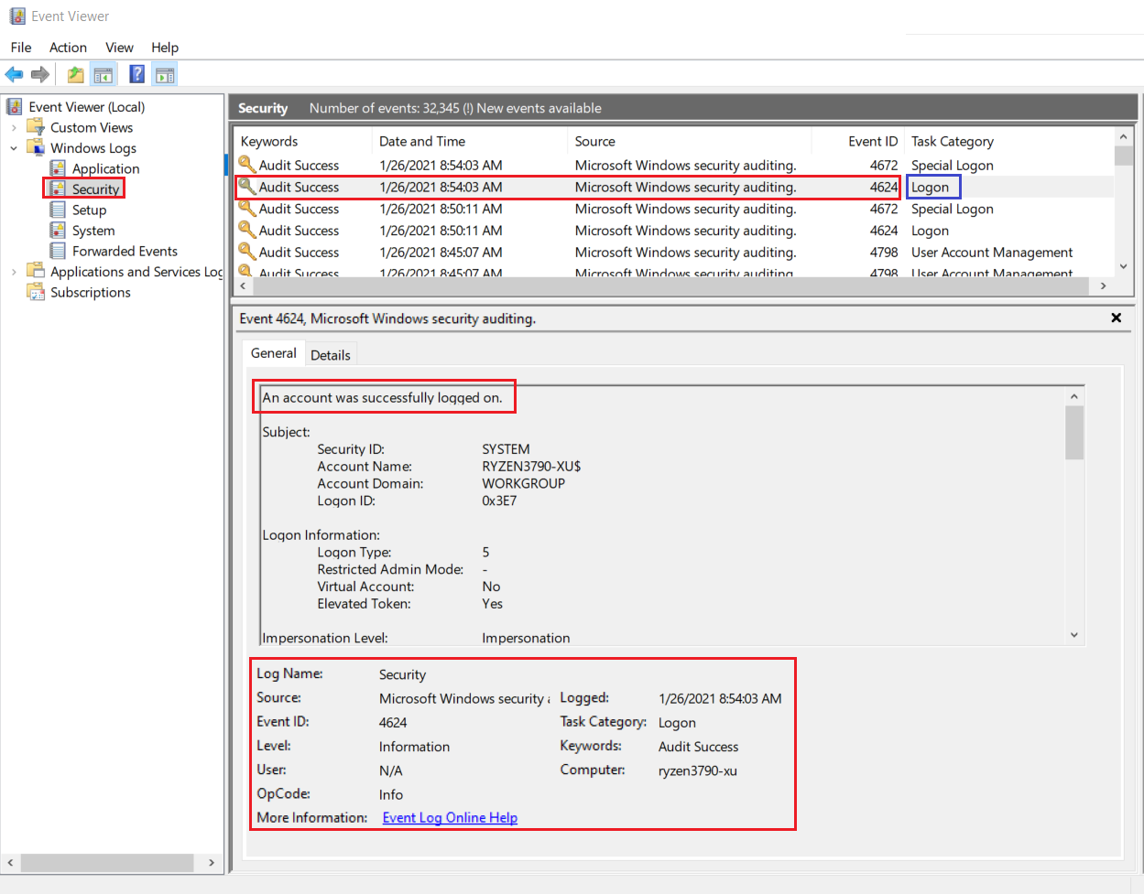
Logon event 4624

Slide 30
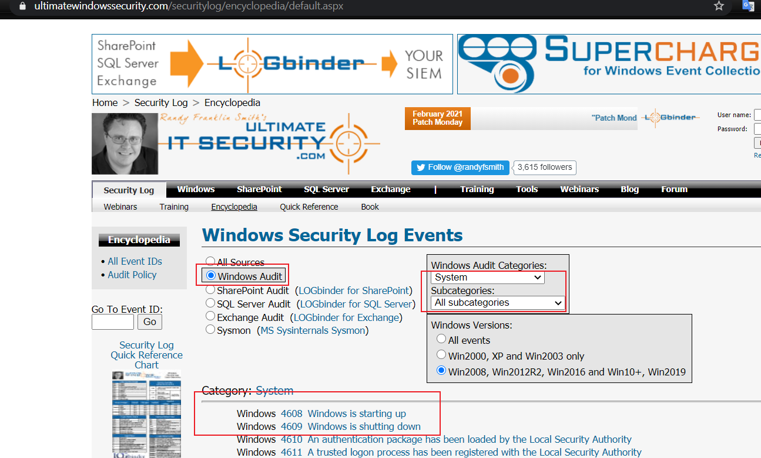
How to search events?
https://www.ultimatewindowssecurity.com/securitylog/encyclopedia/default.aspx

Slide 31
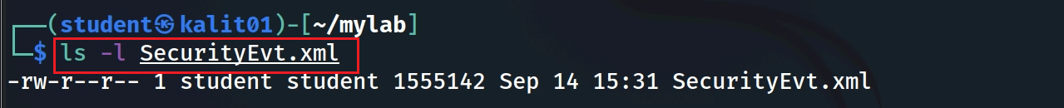
Get a copy of security event log
Please follow Environment Setup Lab and copy Security.evtx to the current folder
Verify the current folder contains Security.evtx
Convert Security.evtx to xml format
Verify .xml file
Notes:
evtx_dump.py Security.evtx > SecurityEvt.xml

Slide 32
Download the cleaned security event log
We cleaned the SecurityEvt.xml
removed all namespaces as the attributes and tags as there are no name conflicts
reformatted in a pretty format (indented)
The cleaned log file is secuirtyEvt_formatted.xml
Two Python codes for removing namespace and reformatting can be found in the repository
securityevt_ns_remove.py and securityevt_format.py
You can directory download the cleaned security log
wget –q https://raw.githubusercontent.com/frankwxu/digital-forensics-lab/main/NIST_Data_Leakage_Case/py_version/pycode/security_evt_xml/securityEvt_formatted.xml
Notes:
wget –q https://raw.githubusercontent.com/frankwxu/digital-forensics-lab/main/NIST_Data_Leakage_Case/py_version/pycode/security_evt_xml/securityEvt_formatted.xml

Slide 33
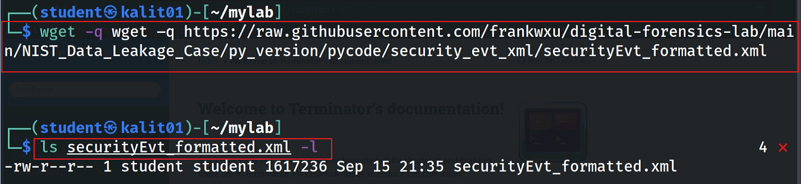
Download cleaned security event log
Notes:
wget –q https://raw.githubusercontent.com/frankwxu/digital-forensics-lab/main/NIST_Data_Leakage_Case/py_version/pycode/security_evt_xml/securityEvt_formatted.xml

Slide 34
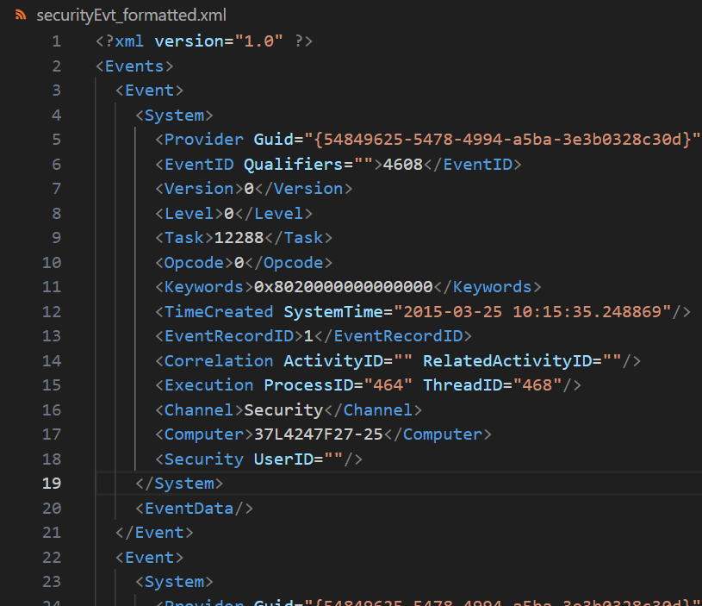
View the cleaned security event log

Slide 35
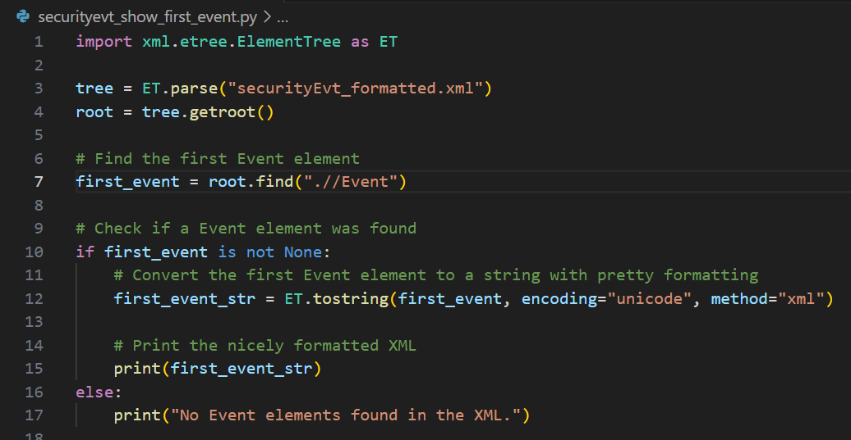
Show the first event

Slide 36
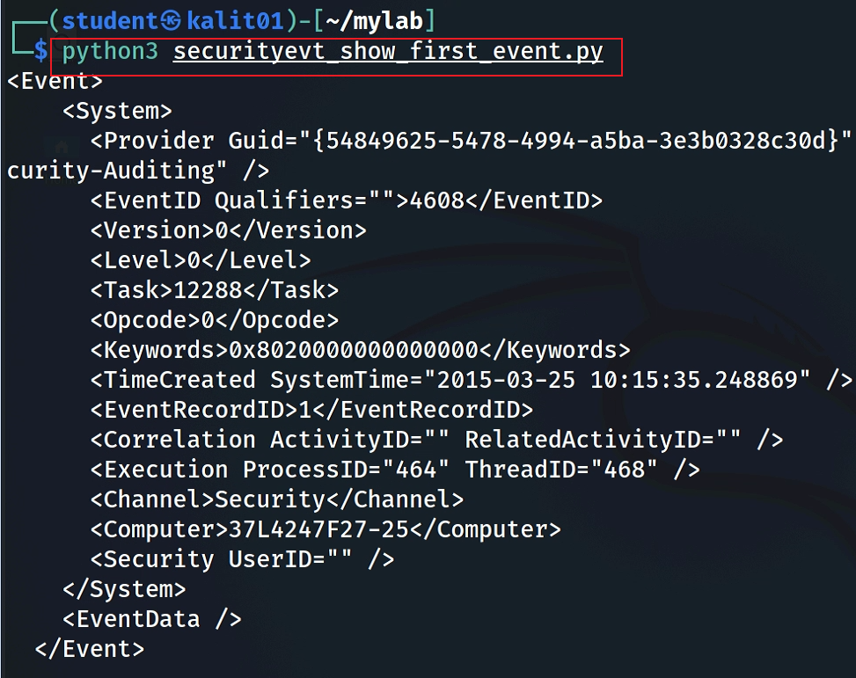
Download Python code
Execution command
Notes:
wget -q https://raw.githubusercontent.com/frankwxu/digital-forensics-lab/main/NIST_Data_Leakage_Case/py_version/pycode/security_evt_xml/securityevt_show_first_event.py

Slide 37
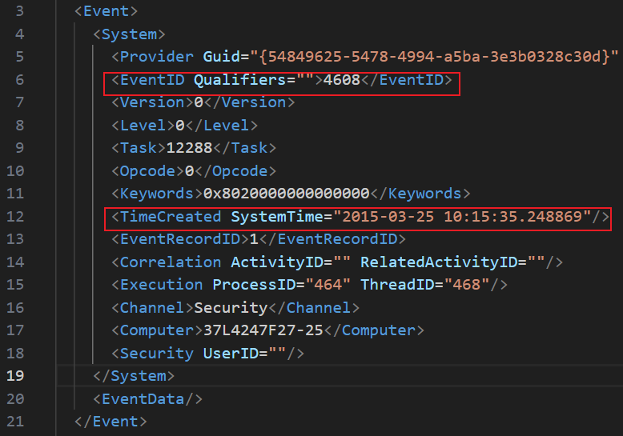
Find when Windows started
4608 (Windows is starting up)
1100 (service shutdown)
4624 (successful logon)
4634 (logoff)
4625 (logon failure)
4647 (a user initiated the logoff process)...
In digital forensics, determining when Windows started (boot time) can be crucial
Timeline Analysis
Incident Reconstruction
Malware Analysis
Unauthorized Access
System Stability and Integrity
Alibis and Altered System Times
Correlation with Other Artifacts
Notes:
Timeline Analysis: Establishing an accurate timeline of events is a fundamental aspect of digital forensics. Knowing when a system was last booted can help forensic analysts understand the sequence of activities on the system. It allows them to correlate events, track user actions, and identify any suspicious or unauthorized activities.
Incident Reconstruction: When investigating security incidents or cybercrimes, forensic analysts need to reconstruct the sequence of events leading up to and following the incident. Boot time is a critical reference point for understanding the context and identifying potential indicators of compromise (IOCs).
Malware Analysis: Malware often attempts to hide its presence and activities on a compromised system. Examining the system's boot time can reveal if malware initiated during startup, helping analysts identify the persistence mechanisms used by the malware and any changes made to the system.
Unauthorized Access: In cases of unauthorized access or insider threats, knowing the boot time can help determine whether someone gained access to a system during a specific time window. This information can be used to establish user account activity patterns and assess potential insider involvement.
System Stability and Integrity: Analyzing boot times can provide insights into the stability and integrity of the system. Frequent or unexpected reboots may indicate hardware or software issues, and this information can be valuable in diagnosing problems.
Alibis and Altered System Times: In legal cases, verifying the boot time can be critical for establishing alibis or disproving false claims. It helps establish when a suspect was or was not using a specific computer system.
Correlation with Other Artifacts: The boot time can be correlated with other digital artifacts, such as log files, user account activity, and file timestamps. This correlation can help build a comprehensive picture of system usage and user actions.

Slide 38
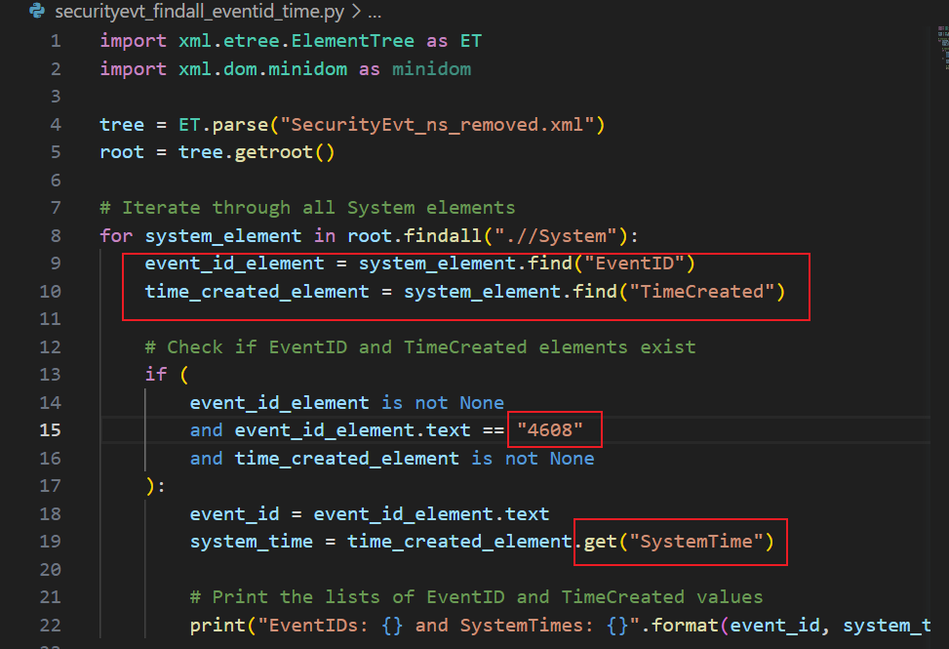
Find all Event ID 4608 (Windows is starting up) and its timestamps

Slide 39
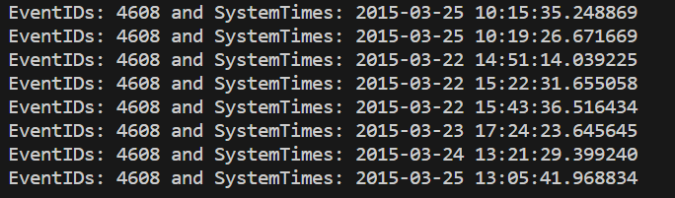
https://raw.githubusercontent.com/frankwxu/digital-forensics-lab/main/NIST_Data_Leakage_Case/py_version/pycode/security_evt_xml/securityevt_findall_eventid_time.py
Execution command
$ python3 securityevt_findall_eventid_time.py
Execution results

Slide 40
Assignments

Slide 41
Assignments
Practice the lab by following PPTs
Find the EventId “4634” (logoff) and its timestamp using Python
Substitute the EventId “4634” with the string “logoff”
Find the string “logoff” with timestamps

